Slide 1


PROP’21 Project Presentation and Demonstration On “SMART ATTENDANCE APP ”
Students:
RACHANAA M RAGHUTHAMA (1RN18CS078)
RIDHA P (1RN18CS086)
VARNIKA BAGARIA (1RN18CS115)
Guide:
NAME: CHETANA H R
DESIGNATION : ASST. PROFESSOR
Department of Computer Science and Engineering
(NBA Accredited for academic years 2018-19, 2019-20, 2020-21)
RNS Institute of Technology
Dr.Vishnuvardan Road, Channasandra, Bengaluru-560 098
2020-21

Slide 2
OUTLINE
Introduction – relevance of the topic
Mini-world- problem statement and Overview
Screen Design Layouts
Tools and Technologies used

Slide 3
Introduction- relevance of the topic
Manual systems are time consuming and inefficient. In the proposed project Smart Attendance App is designed such that it is less time consuming, safe, effective and at the ease of the fingertips.
It is just a matter of SwitchCompat for the teachers and just a matter of fingerprint for the students.
User Friendly
Minimal paper work.
Time Saving
Efficient attendance tracking

Slide 4
Mini-world- problem statement and overview
Student attendance management system deals with the maintenance of the student’s attendance details. The catch here is that it uses the fingerprint of the student to clock the attendance which is maintained on daily basis.
The staffs will be provided with the separate username & password which can be used to login and view the attendance of any particular day as and when required.
Student again has a different login to mark their attendance by authenticating through their fingerprint.
This system will also help in evaluating attendance eligibility criteria of a student.
Report of the student’s attendance on weekly and monthly basis is generated.

Slide 5
requirements
Smart phone with a finger print sensor
Minimum android sdk version – 26
Target sdk version – 30
Minimum android version 8 (Oreo)

Slide 6
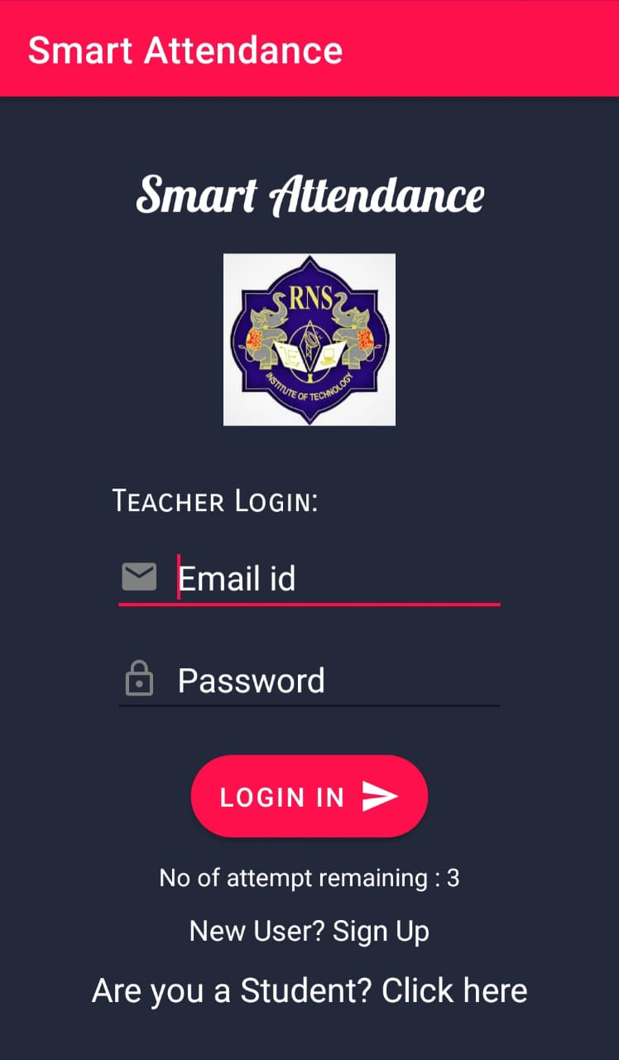
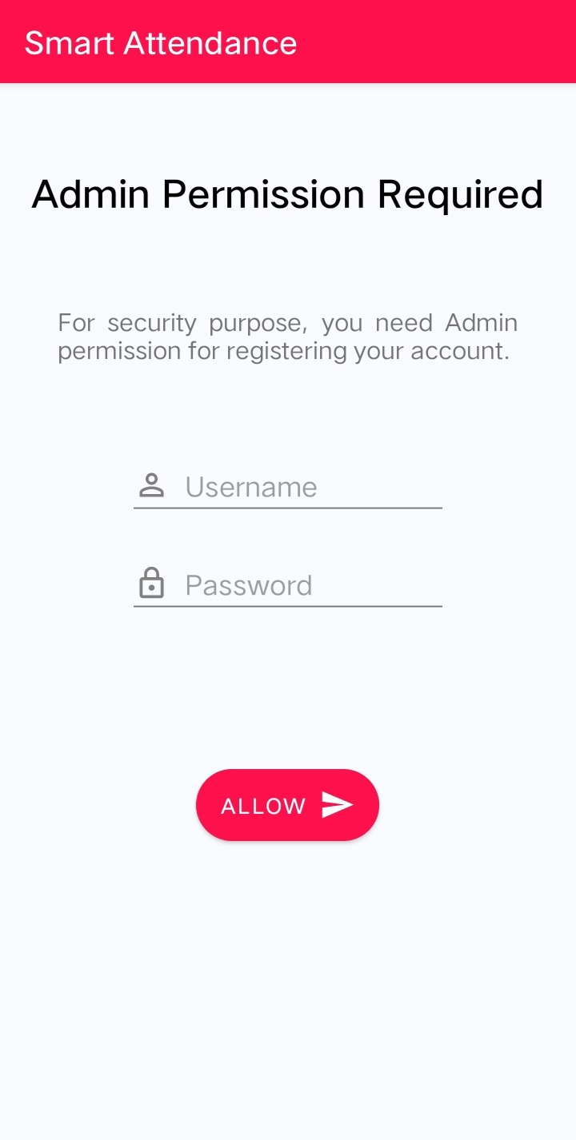
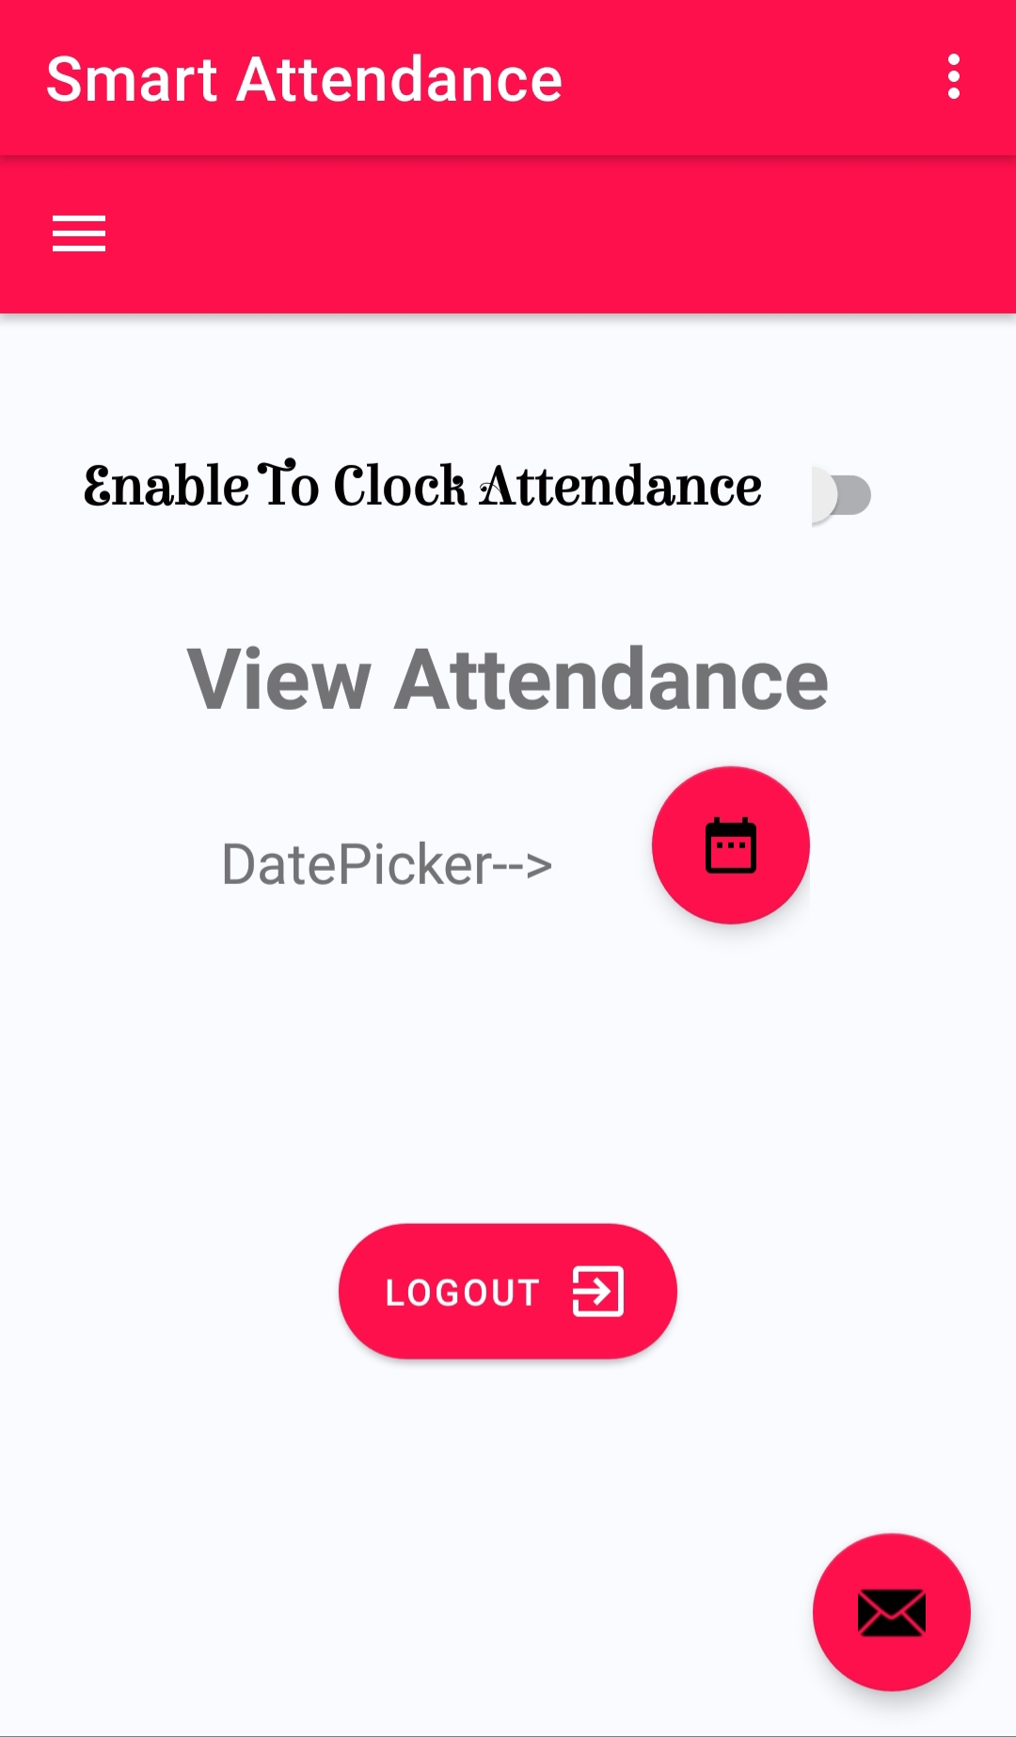
Screen Design Layouts

Slide 7
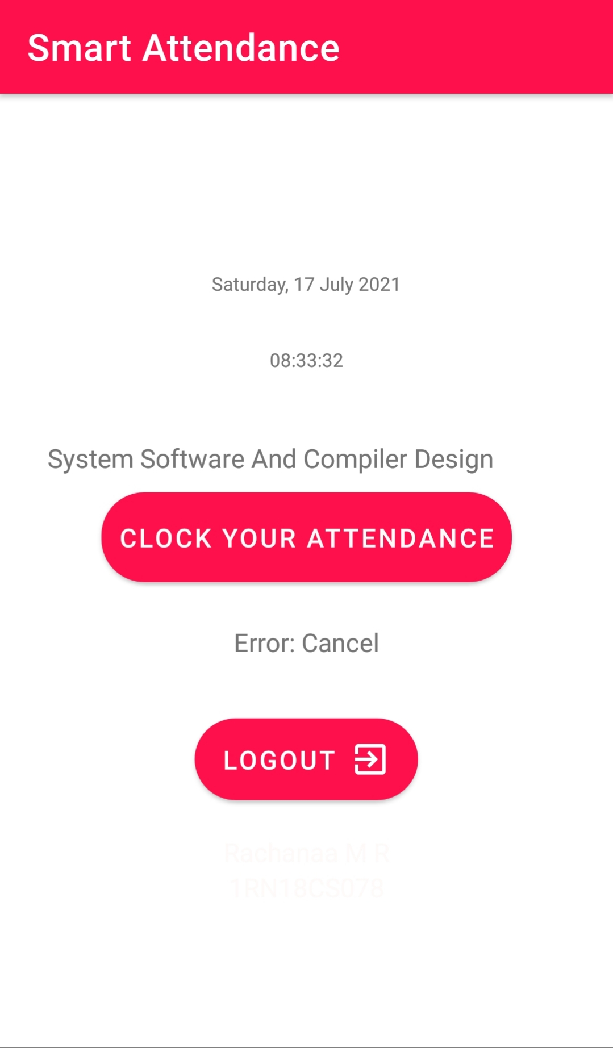
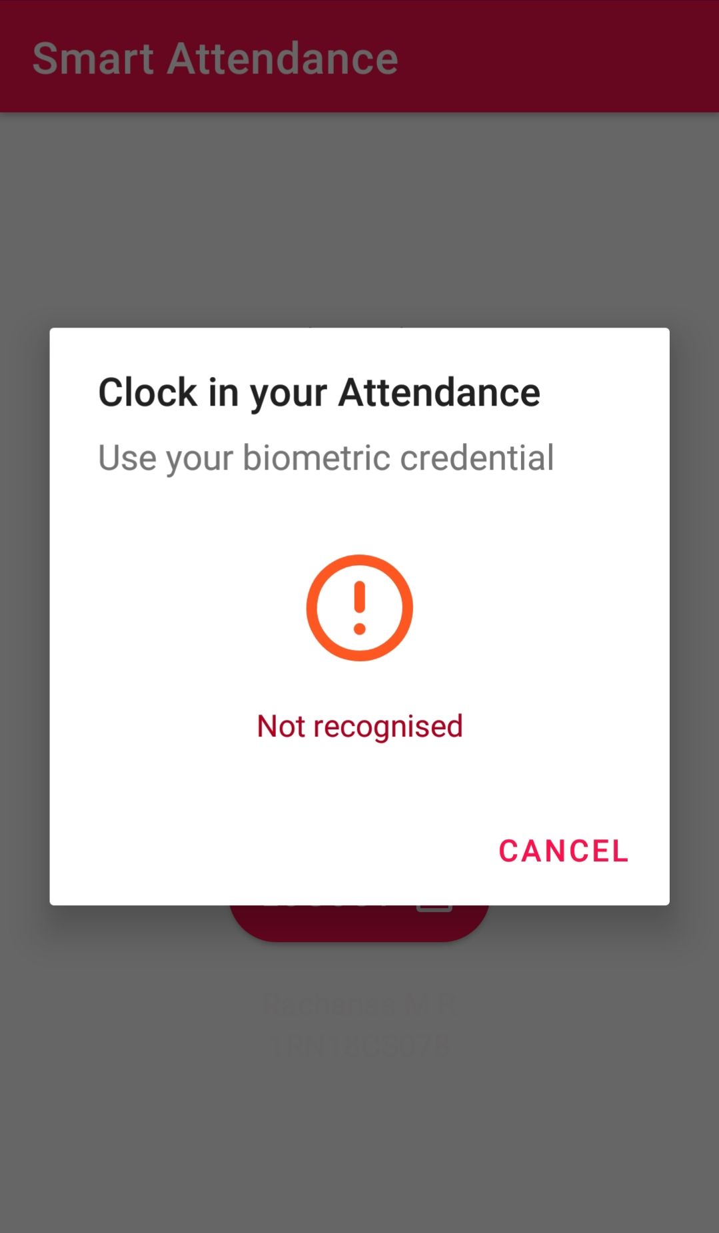
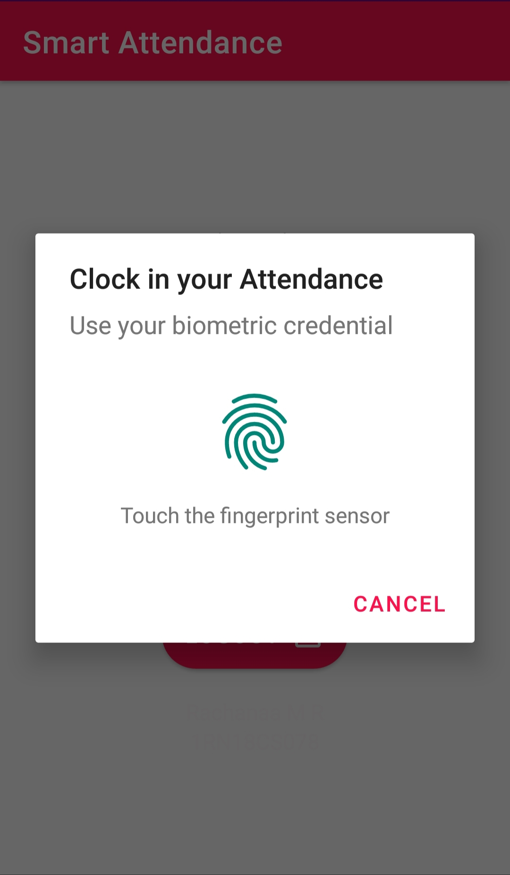
Screen Design Layouts

Slide 8



Tools and technologies used
Android Studio version 10.
Firebase Realtime Database for Storage.
Firebase authentication.

Slide 9
Thank you
Queries ??

